Slide 1
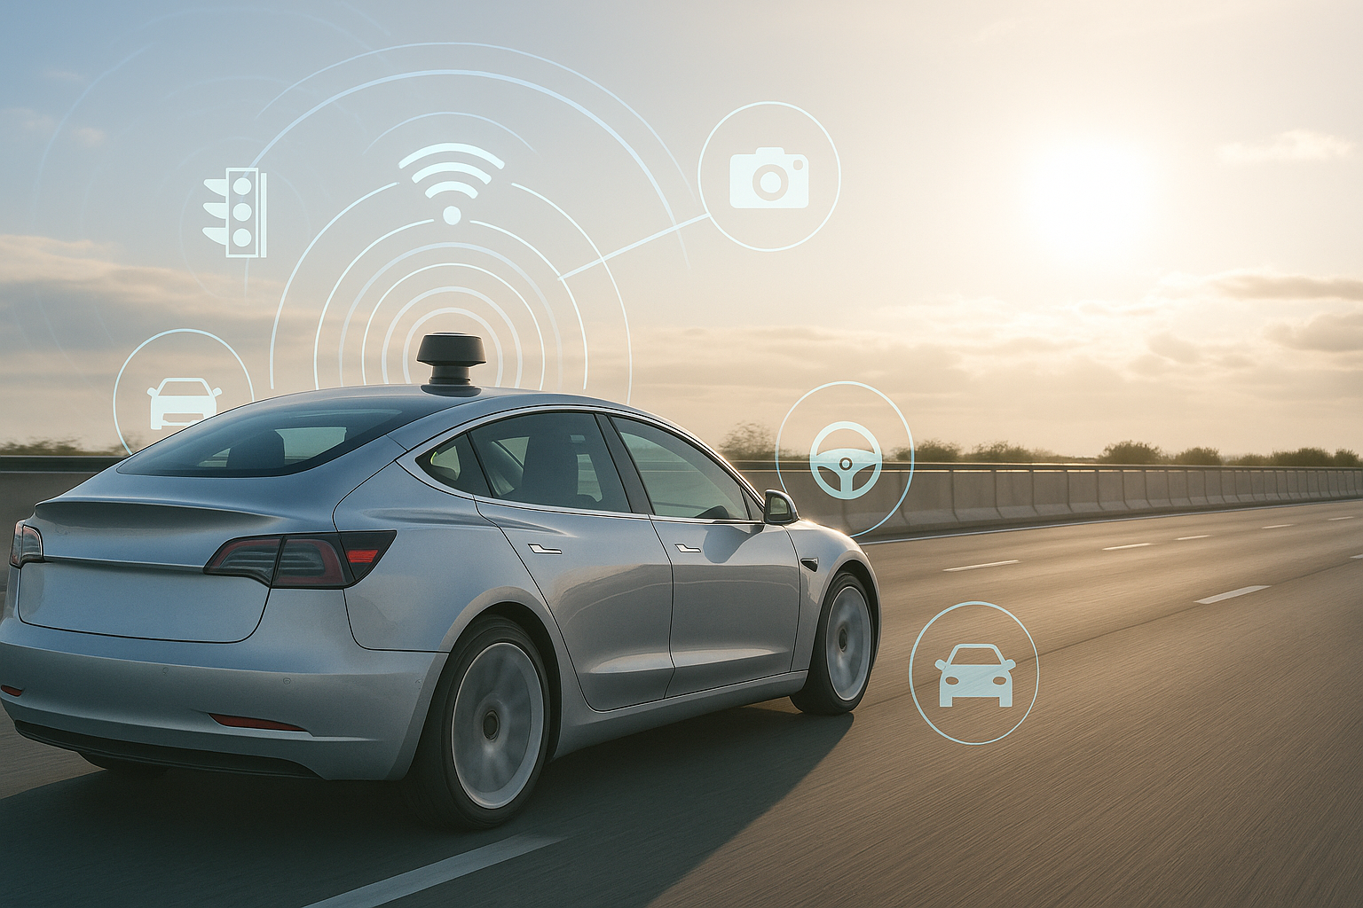

Flexible Sensor Data Abstraction in SDVs with Middleware-Driven Approach
Institute of Industrial Automation
and Software Engineering
Aniket Barve
Research Project FA-3810
Supervisor: Akshay Narla, MSc

Slide 2
Agenda
Introduction
Basis
Concept
Evaluation
Conclusion

Slide 3
Introduction

Slide 4
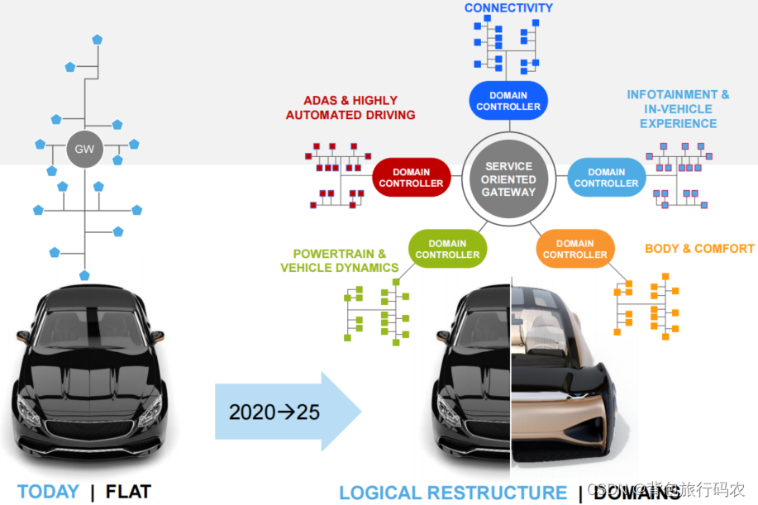
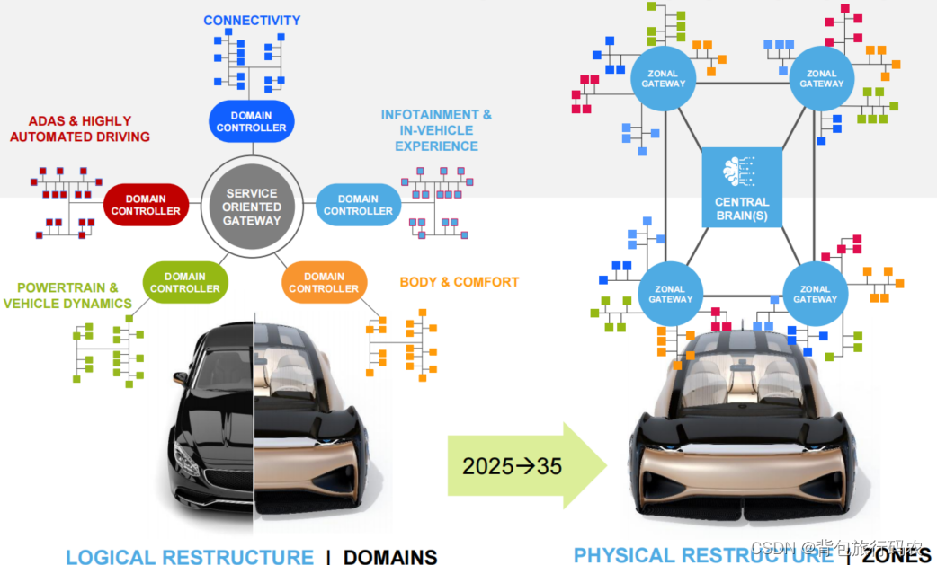
Introduction
Motivation
CASE transformation in automotive industry:
Source: https://blog.csdn.net/zhuwade/article/details/122702632
Source: https://blog.csdn.net/zhuwade/article/details/122702632
Software Defined Vehicles: the shift from Hardware-Centric to Software-Centric Vehicles
Challenges
Standardization
Hardware-Software Coupling
Lack of Interoperability
High computational requirements

Slide 5
Introduction
Problem statement
SDVs integrate diverse sensors (camera, LIDAR, radar, etc.)
Each vendor uses proprietary formats and protocols
Lack of standardization limits the reuse of algorithms
Real-time abstraction across heterogeneous sensors is computationally intensive and error-prone
Camera
Radar
LiDAR
Sensors
SOFTWARE
How can we efficiently abstract and standardize data from heterogeneous sensors in real time within Software-Defined Vehicles (SDVs)?

Slide 6

Introduction
Objective
How our approach improves upon traditional sensor middleware?
Traditional Middleware
Raw sensor-specific data
Tight coupling between sensor and software logic
Structured data mapped to VSS tree
Signals exposed through Kuksa Databroker
No standardized signal format
Difficult to reuse or extend
Applications access data via hardware-agnostic APIs
Enables interoperability, modularity, and real-time sync
Middleware with
DDS/Zenoh, VSS, Kuksa (Our system)

Slide 7
Basis

Slide 8
Basis
Definitions
SDV: Software Defined Vehicle [1]
Middleware: A Layer between sensors and APIs [2]
DDS: Data Distribution Service (Real-time, pub/sub protocol for structured systems) [3]
Zenoh: Lightweight protocol for pub/sub + data queries [4]
Kuksa Databroker: Shares VSS signals [6]
VSS: Vehicle Signal Specification [5]

Slide 9
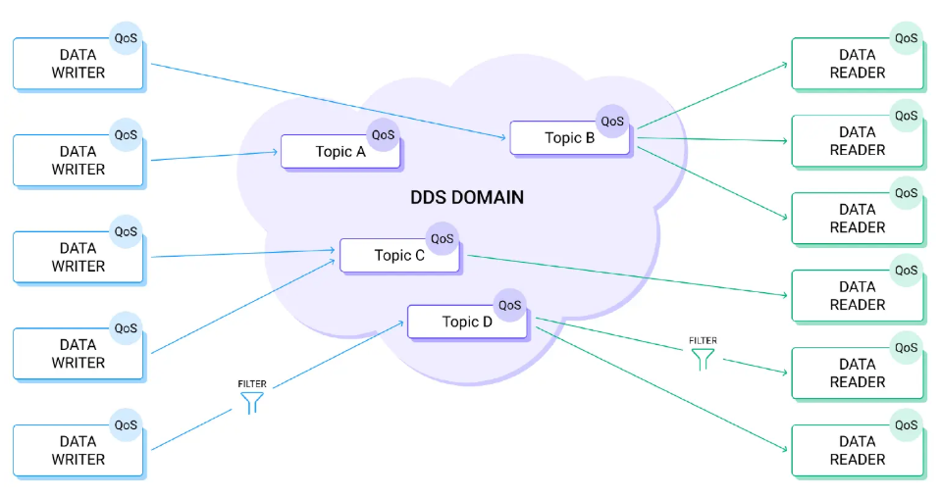
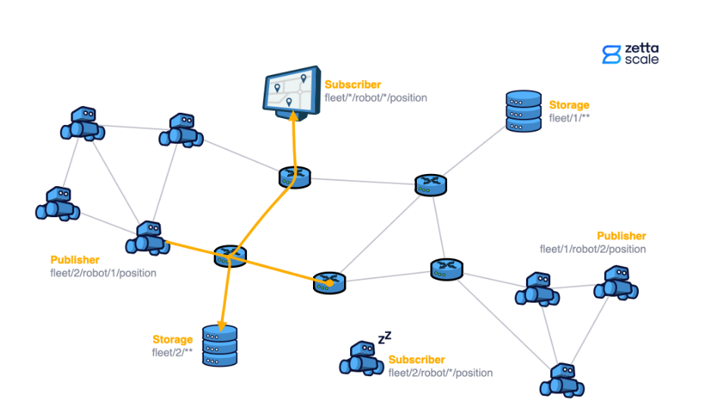
Basis
Literature review
DDS: Architecture
Zenoh: Architecture
Source: https://www.emqx.com/en/blog/navigating-dds-basics-limitations-and-integration-with-mqtt
Source: https://zenoh.io/docs/overview/zenoh-in-action/#pubsub-in-zenoh
Real-time publish/subscribe middleware.
Topics connect Data Writers and Readers with QoS control.
Widely used in ADAS, aerospace, and SDV middleware
Lightweight pub/sub + query protocol for edge devices.
Ideal for peer-to-peer SDV communication without brokers.
Considered for future SDV decentralization

Slide 10
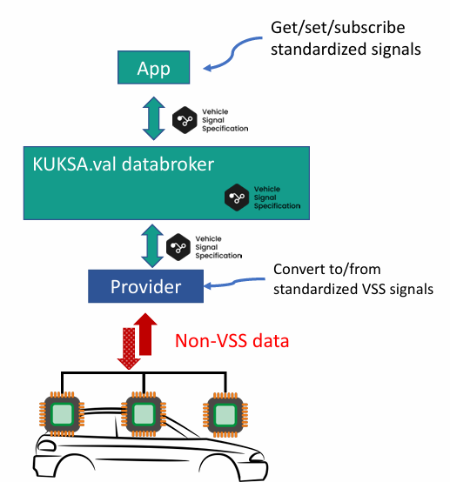
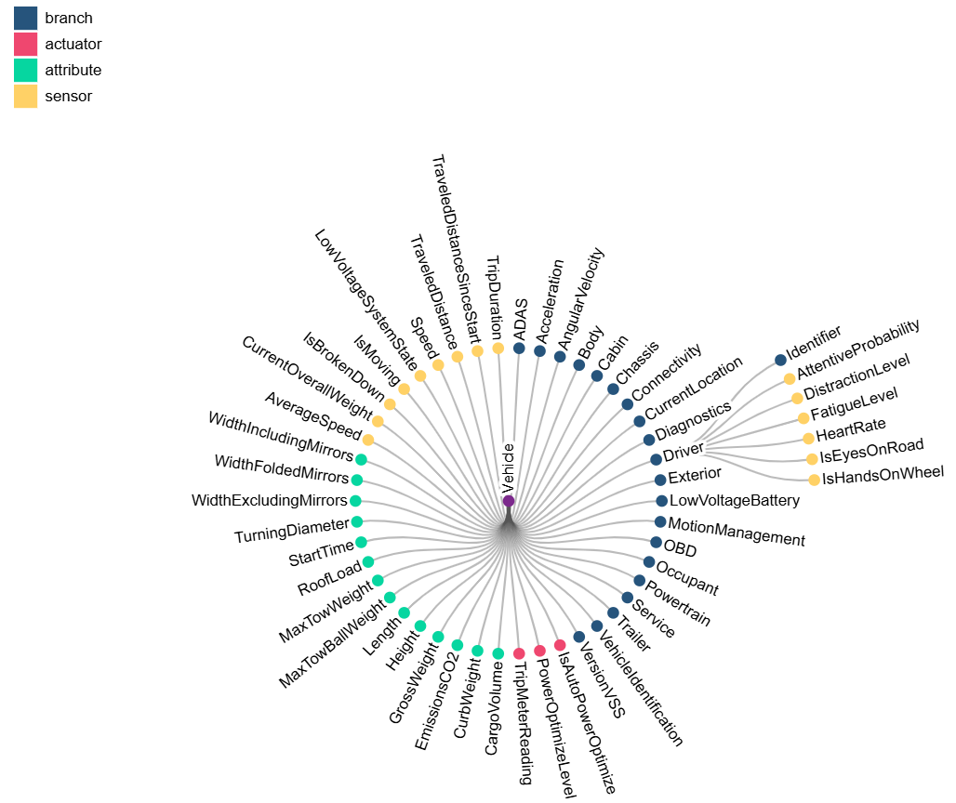
Basis
Literature review
VSS: Tree Model
Kuksa
Databroker
Source: https://covesa.github.io/vehicle_signal_specification/introduction/
Source: https://archive.fosdem.org/2023/schedule/event/kuksa/
Makes data vendor-agnostic, structured, and reusable
Used to standardize raw sensor or ECU data
Signal structure: Vehicle.ADAS.LaneDeparture.IsError
Helps decouple applications from hardware
Middleware to read/write VSS signals via APIs
Supports: gRPC, WebSocket, REST
Connects directly to DDS, MQTT, CAN, etc.
Enables secure access (roles, permissions)

Slide 11
Concept

Slide 12
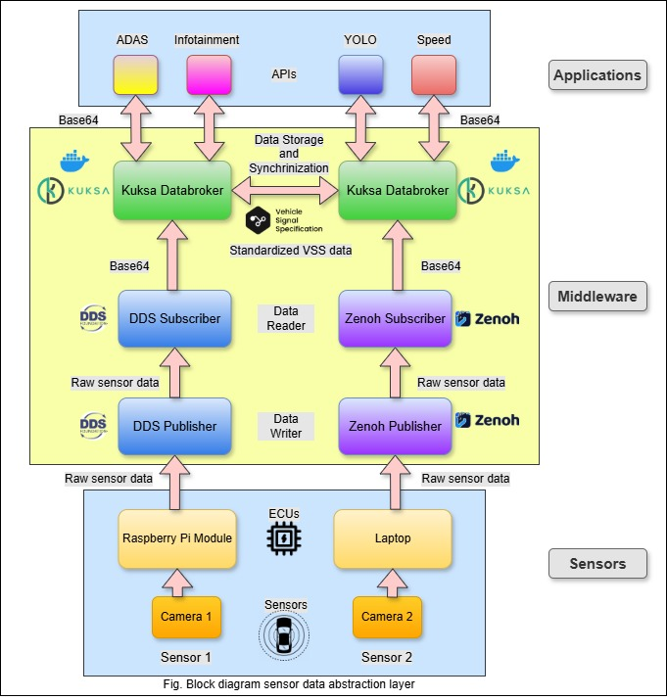
Concept
Prototype block diagram
Abstract raw data using DDS and Zenoh
Standardize signals via Kuksa Databroker and VSS
Ensure interoperability across ECUs in real-time
Enable vendor-agnostic, modular signal access

Slide 13
Evaluation

Slide 14
Evaluation
Signal Flow in the Prototype
Publish
Subscribe
Kuksa (VSS)
Data sync
API- Detection

Slide 15
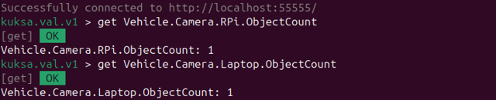
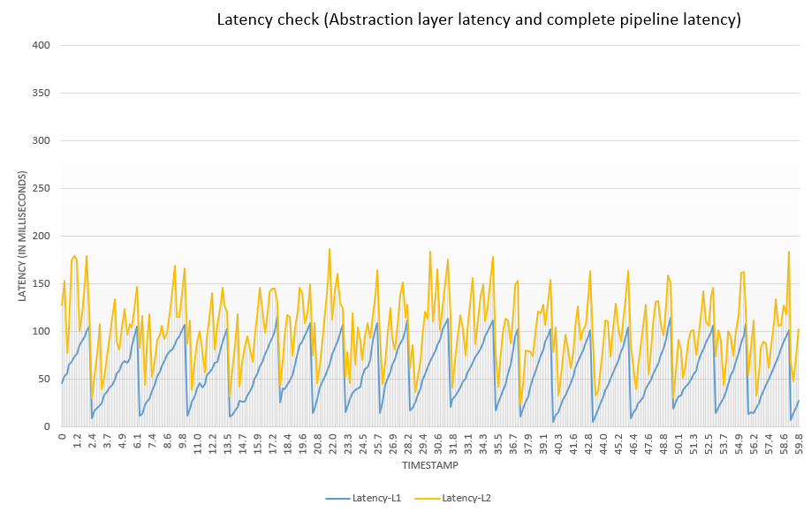
Evaluation
Results
Kuksa Databroker: VSS data sync (Interoperability)
Latency check
(1 minute log with 5fps)
L1: Abstraction layer latency
(DDS/Zenoh → Kuksa)
L2: End-to-end latency
(DDS/Zenoh → Object detection)
Note: Latency was measured on a system with Intel i5-12450H CPU and 16 GB RAM. Results may vary based on processor and memory performance.

Slide 16
Evaluation
Results
“For safety-critical applications like autonomous driving, a sensor-actuator end-to-end latency of 100ms is targeted.” [Betz et al., IEEE IV 2023]
Source: https://ieeexplore.ieee.org/document/10186686
*Betz’s system used an i7 CPU and 32 GB RAM
And final average end-to-end latency was 152ms.
Achieved an average end-to-end latency of ~102ms.
Demonstrates that our abstraction pipeline enables real-time performance while maintaining modularity and interoperability.
 | L1 (mS) | L2 (mS)
Minimum | 5 | 23
Maximum | 116 | 186
Average | 57.14 | 102.06

Slide 17
Conclusion and Future Scope

Slide 18


Conclusion
Conclusion
Future Scope
Developed a working sensor abstraction prototype for SDVs
Integrated different sensor (RPi and USB camera) using DDS and Zenoh
Standardized data using VSS and shared it via Kuksa Databroker
Achieved real-time latency (avg. < 200 ms per frame)
Demonstrated modular, interoperable signal access across ECUs
Evaluate scalability with multiple ECUs in a network
Add support for more sensor types (e.g., LiDAR, radar, IMU)
Replace base64 strings with binary image streaming (e.g., gRPC streaming)

Slide 19
References
[1] Madhuri, Tanuku SaiLakshmi; Bala Vishnu, J. (2025): Software-Defined Vehicles: The Future of Automobile Industry, pp. 192–197. DOI: 10.1109/COMSNETS63942.2025.10885701.
[2] Dr. Arunkumar M. Sampath (2025): Software defined vehicles transforming the future of mobility. Available online at https://www.telematicswire.net/mobility-in-the-future-will-be-transformed-by-software-defined-vehicles/, checked on 4/1/2025.
[3] Neil Puthuff: DDS-The-Data-Backbone-of-SDV-Interoperability_V1_1024.
[4] Eclipse Zenoh: Zenoh. Eclipse Foundation. Available online at https://zenoh.io/.
[5] COVESA: Vehicle-Signal-Specification-Enabling-Ecosystems_20240105. Available online at https://covesa.global/vehicle-signal-specification/, checked on 4/2/2025.
[6] Github: Kuksa-databroker. Available online at https://github.com/eclipse-kuksa/kuksa-databroker.

Slide 20

Institut of Industrial Automation
and Software Engineering
Aniket Barve
st188717@stud.uni-stuttgart.de
Institute of Industrial Automation
and Software Engineering

